Slide 1
R Introduction
Lunch and Learn
1/8/2018

Slide 2
What’s Unique about R
Object Orientated
Data frame
Vectors
List
Dictionaries
Presentation
Limited output
Rounding
Updates
Machine learning
Use of API’s and Online Publishing
twitteR package

Slide 3
Compared to Stata and SAS
Stata
SAS
R
Command-line interface
One command can be used at a time
Programming simplicity
Can use scalars and matrices to imitate some uses of object-orientated programming
Can use Mata to improve presentation
Has limited ability to use html and MS Office
Outputs as tables
Procedure-based
Division between Data steps and Procedure steps
This can be less flexible
Complex/Powerful macros
Can connect to MS Office easily
Output is massive
Function-based
Can use functions within functions
Syntax can be harder to read
Macro capabilities are a bit questionable (or perhaps I don’t understand them well enough)
Output is minimal and customizable

Slide 4
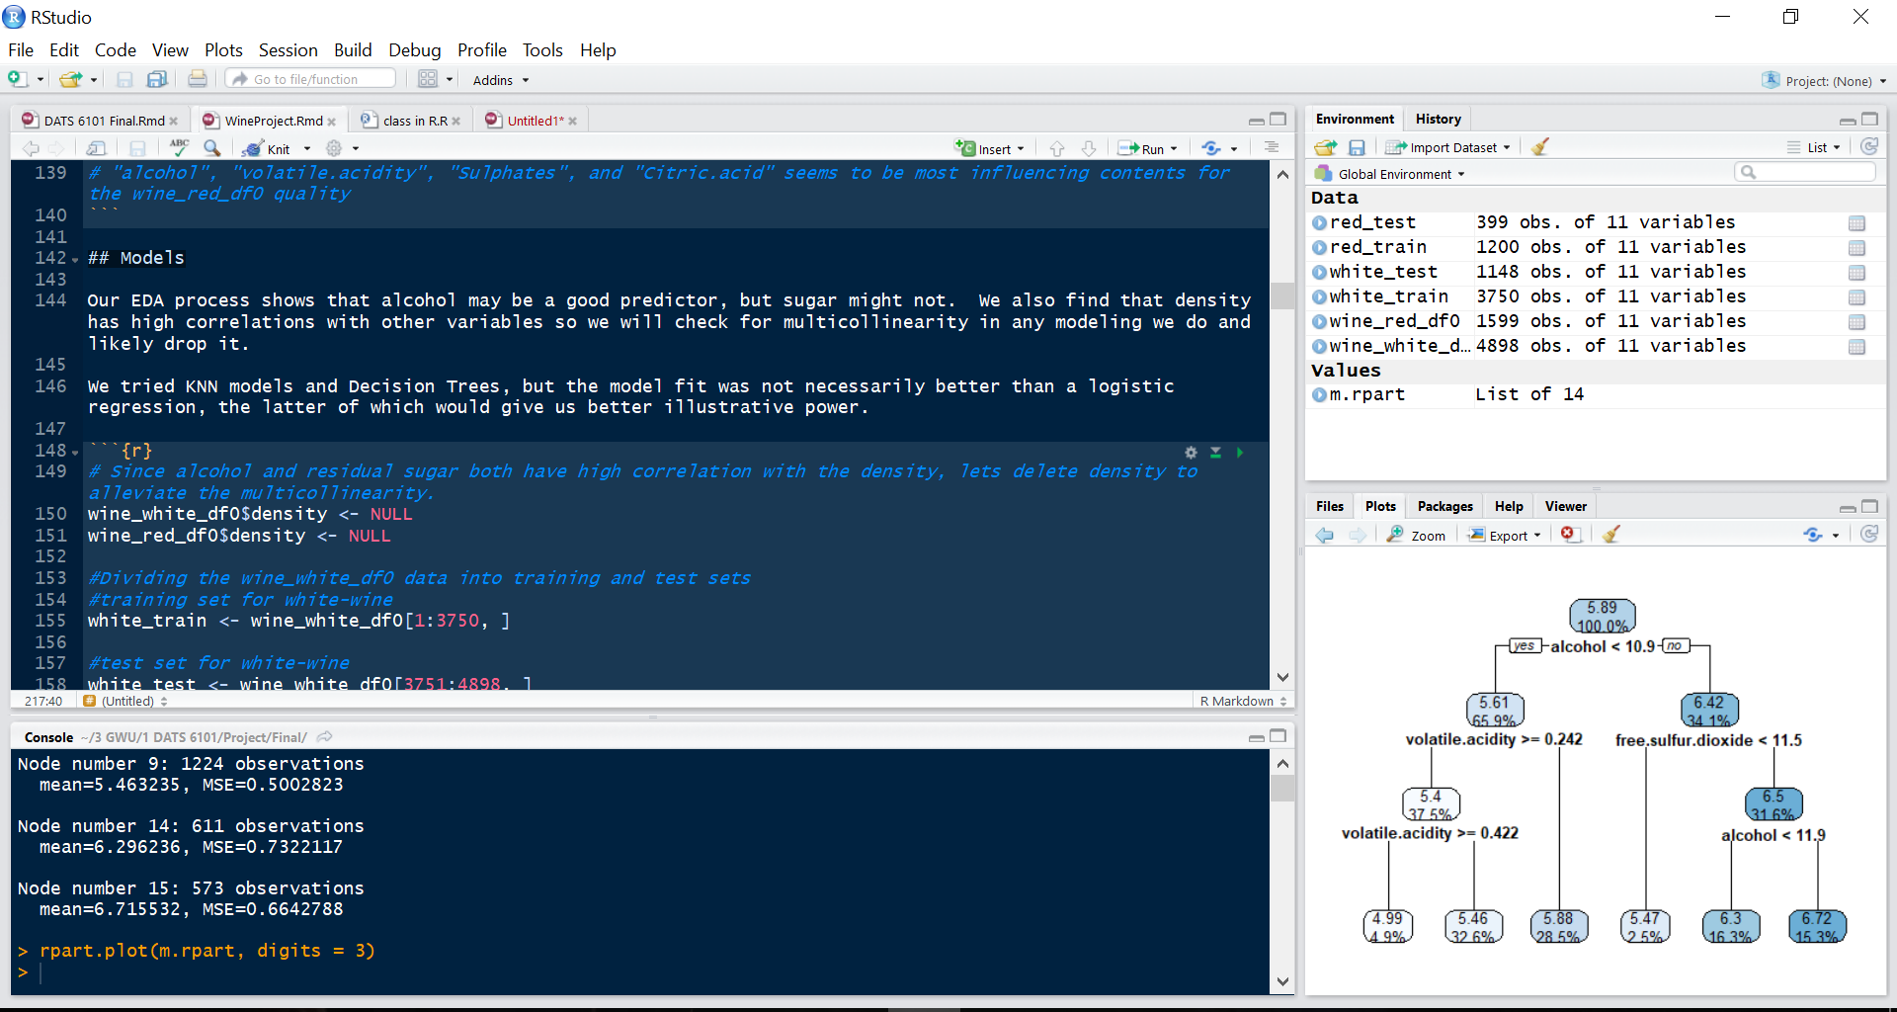
R Studio

Slide 5
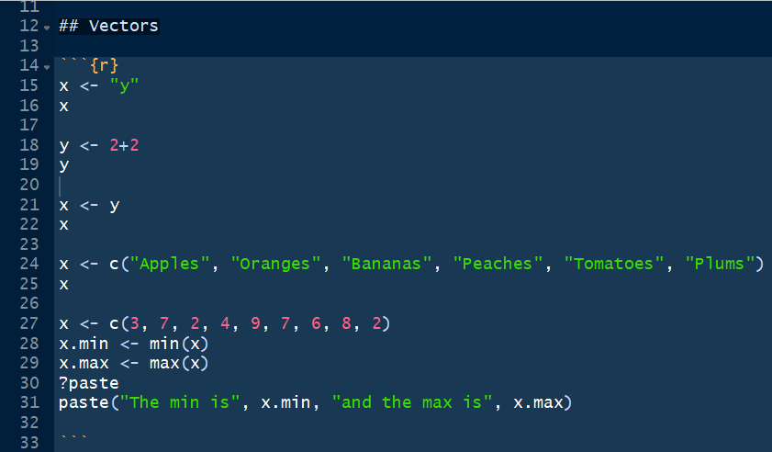
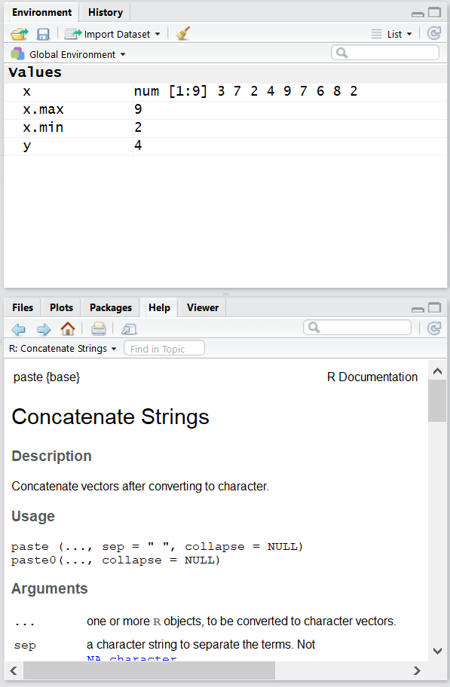
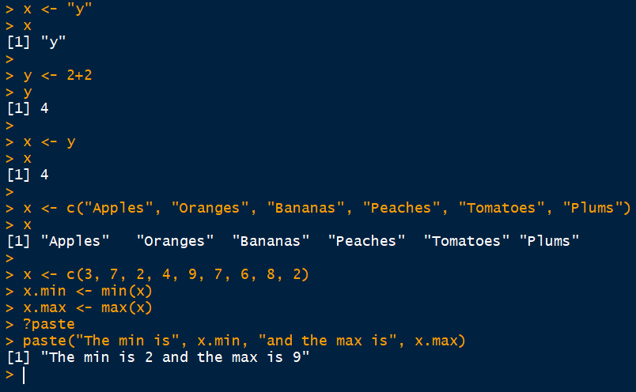
Vectors

Slide 6
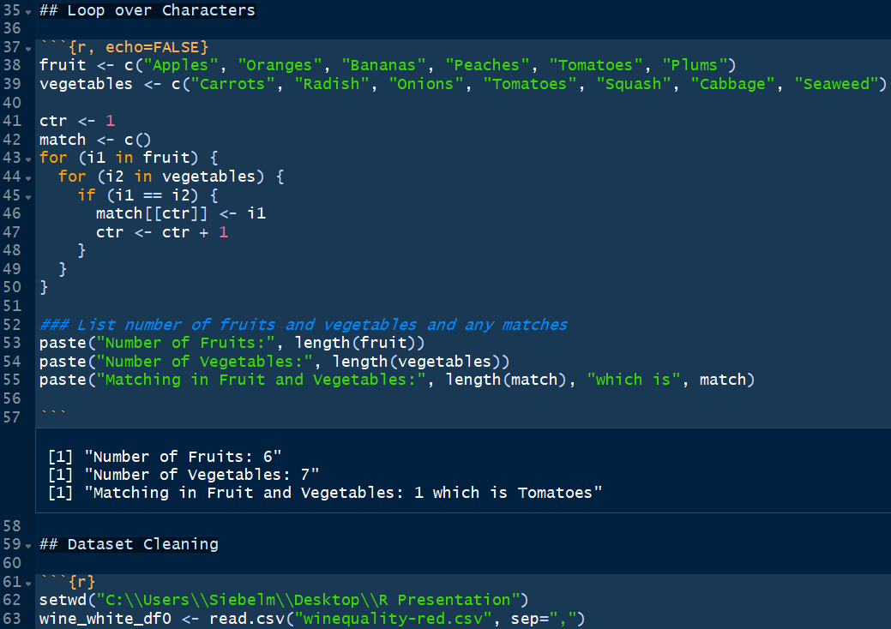
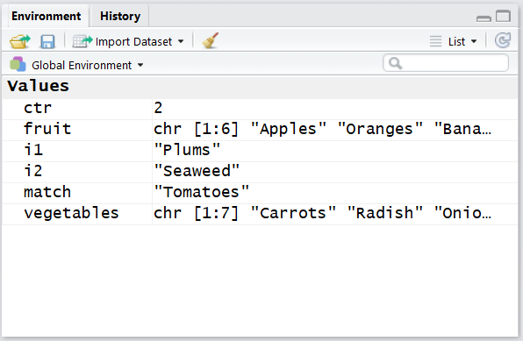
Loop over Characters

Slide 7
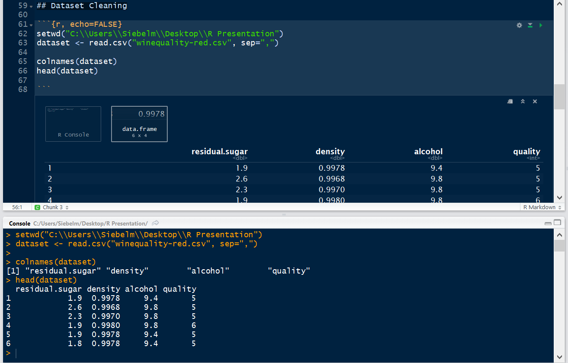
Dataset Cleaning

Slide 8
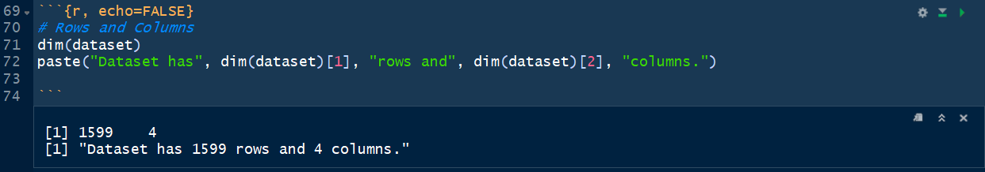
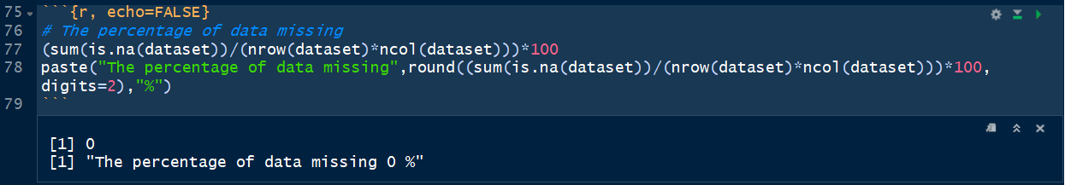
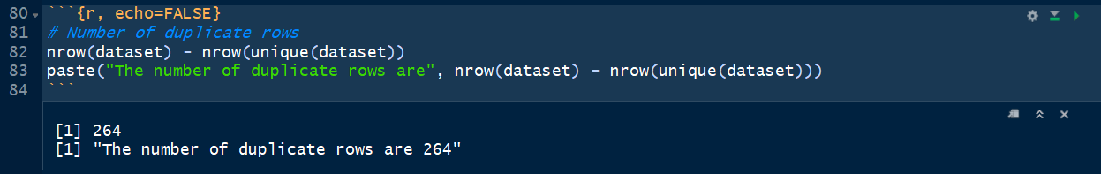
Dataset Cleaning

Slide 9
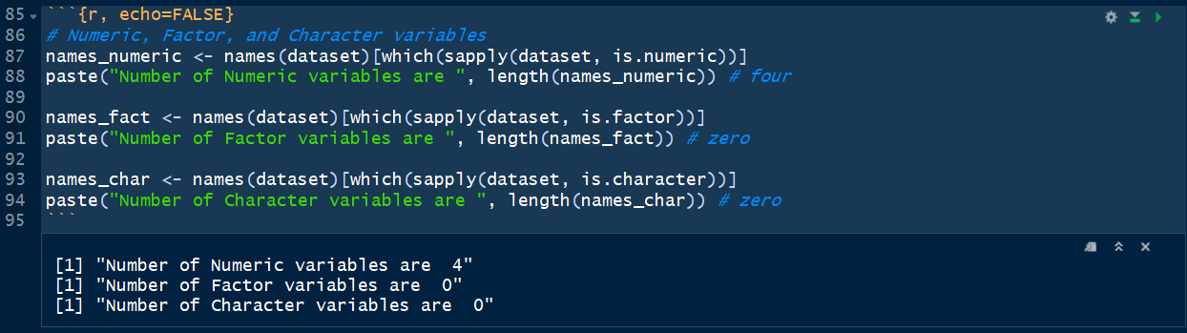
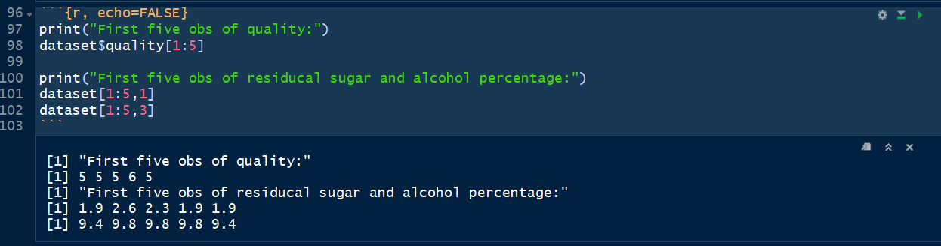
Dataset Cleaning

Slide 10
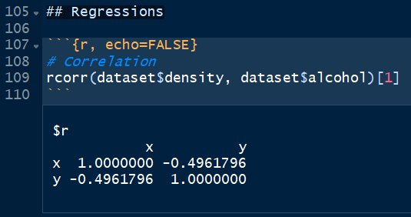
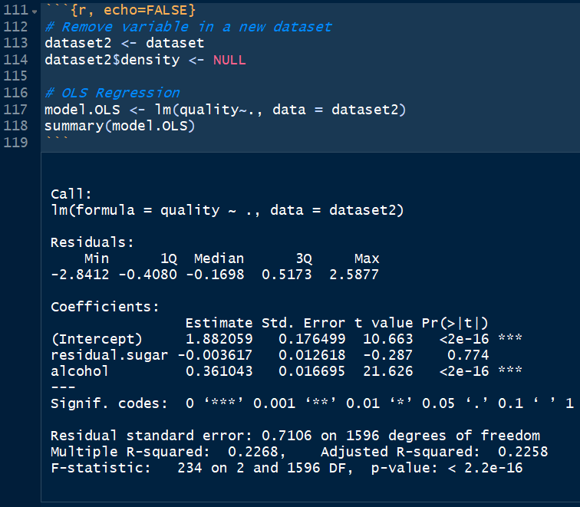
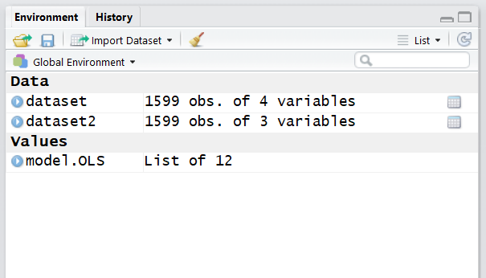
OLS Regression

Slide 11
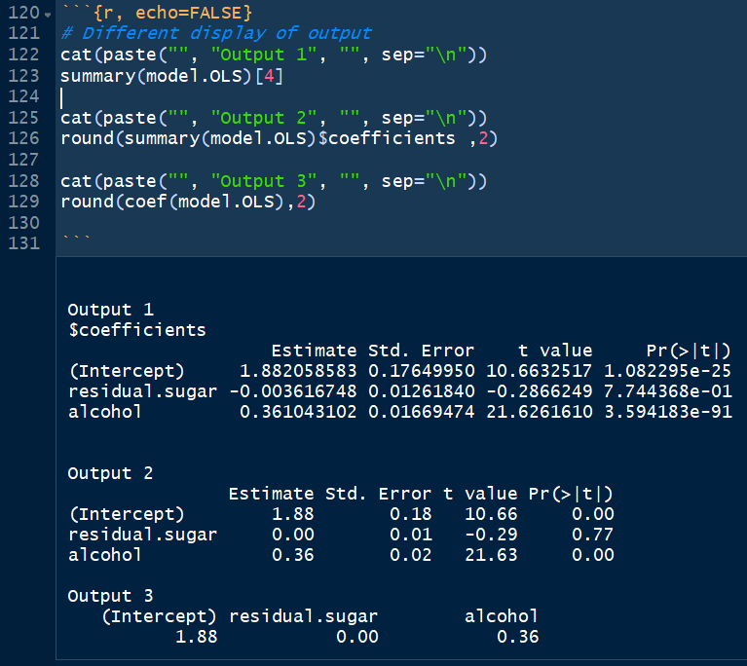
OLS Regression

Slide 12
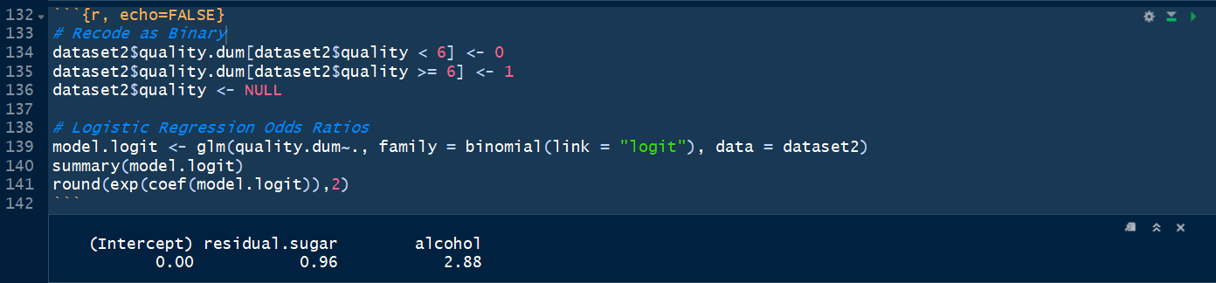
Logistic Regression

Slide 13
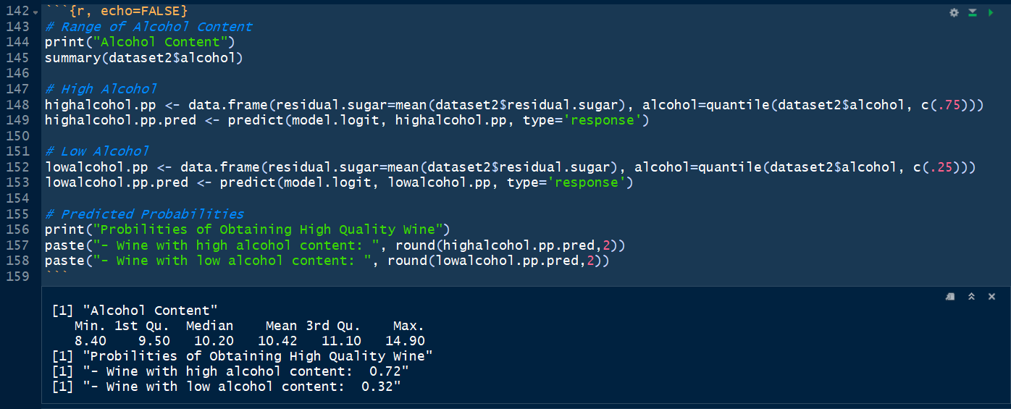
Logistic Regression

Slide 14
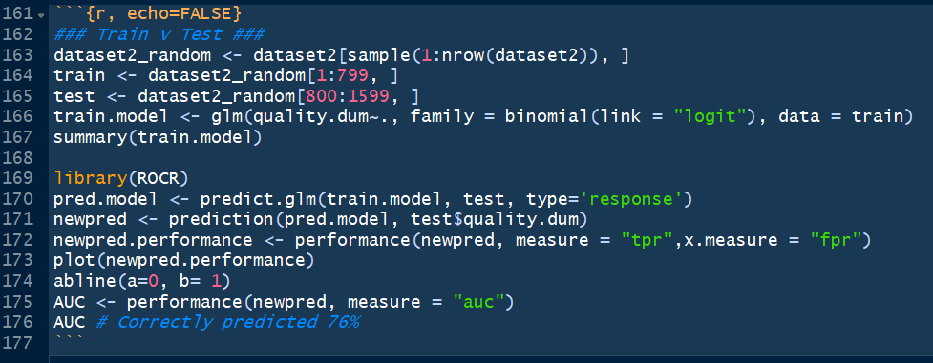
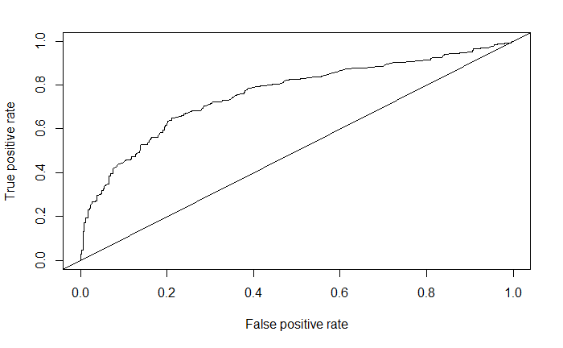
Area Under the Curve

Slide 15
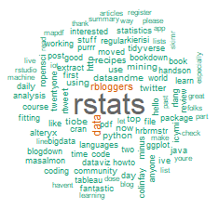
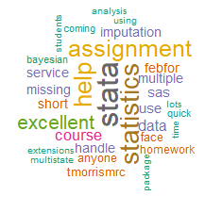
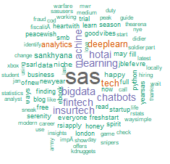
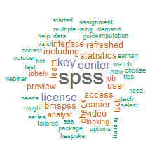
twitteR
R
SPSS
SAS
Stata
Notes:
http://rpubs.com/Siebelm/341162

Slide 16
Thank You
Final note: R can publish an R Markdown file to Rpubs in one click
http://rpubs.com/Siebelm/RIntroLandL

